Slide 1
Conducting a meta analysis
Dr Andy Fugard
a.fugard@ucl.ac.uk
7th Dec 2016

Slide 2
Plan for today
Overview of meta-analysis
Illustration through Ed Psych-relevant examples
Sketch of how to conduct an analysis
Focus on collecting the information you need
You don’t actually have to fit the statistical model during the DECPsy (but you can!)
A couple of arithmetical activities along the way
Postscript: why you can’t ask a genie for more wishes

Slide 3

So… you’ve survived your systematic review
You now have a collection of results, perhaps evaluating the effectiveness of an intervention
The outcome measures are probably similar but not identical across studies
The analyses also vary a little: means and SDs, t-tests, ANOVA, maybe standardised effect sizes…
How can you synthesise this?

Slide 4
Putting meta-analysis in context (Glass 1976)
Primary analysis: original data analysis
Secondary analysis: re-analysing data, e.g., with a better statistical approach or to answer new questions
Meta analysis: analysis of analyses
“… the statistical analysis of a large collection of analysis results from individual studies for the purpose of integrating the findings” (Glass 1976, p. 3)

Slide 5
What can a meta-analysis do for you?
Estimate pooled effect size from 2 or more studies
Estimate how consistent effects are
Test for publication bias
Test for moderators of effects
Graphical summaries of a lot of information

Slide 6
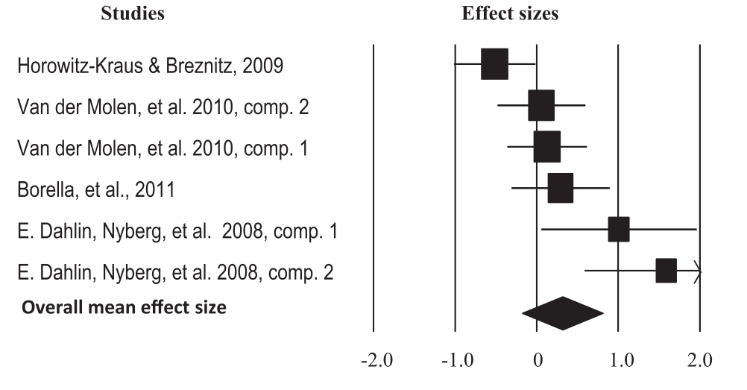
Illustrative Example (forest plot)
Melby-Lervåg, M., & Hulme, C. (2013). Is working memory training effective? A meta-analytic review. Developmental psychology, 49(2), 270–91.

Slide 7
Illustrative Example (forest plot)
Individual studies
(95% confidence intervals
of individual effects)
Melby-Lervåg, M., & Hulme, C. (2013). Is working memory training effective? A meta-analytic review. Developmental psychology, 49(2), 270–91.

Slide 8
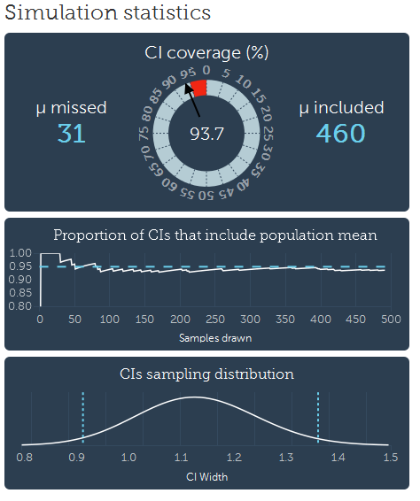
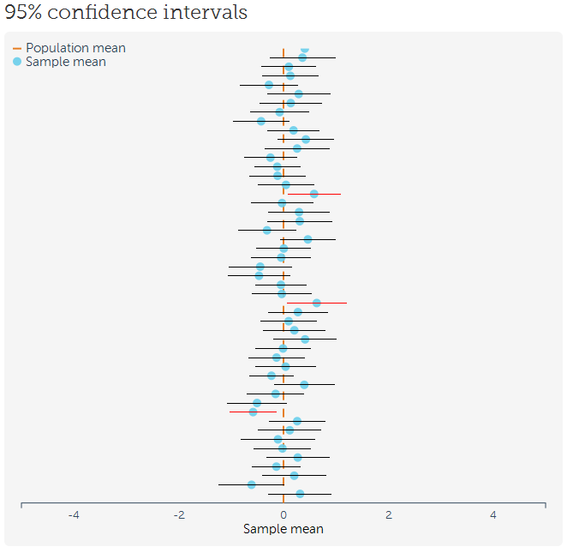
As promised last time: confidence intervals
http://rpsychologist.com/d3/CI/

Slide 9
Illustrative Example (forest plot)
The box size is bigger when the confidence interval is more precise (narrower) to draw your eye towards it
Melby-Lervåg, M., & Hulme, C. (2013). Is working memory training effective? A meta-analytic review. Developmental psychology, 49(2), 270–91.

Slide 10
Illustrative Example (forest plot)
Pooled effect
(95% confidence intervals includes zero so not statistically significant)
Melby-Lervåg, M., & Hulme, C. (2013). Is working memory training effective? A meta-analytic review. Developmental psychology, 49(2), 270–91.

Slide 11


Slide 12
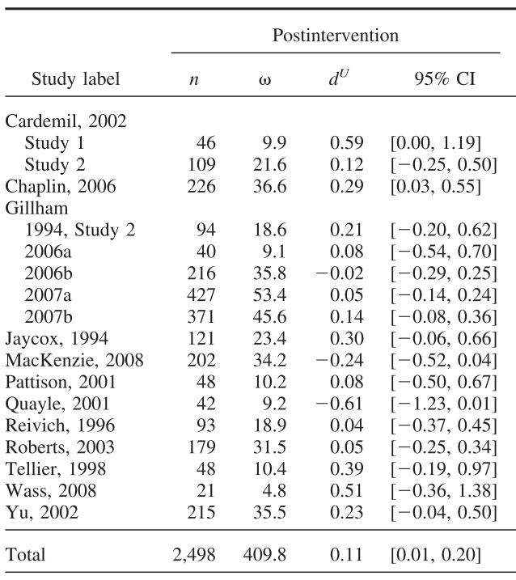
You can also express the information in a table
Brunwasser, S. M., Gillham, J. E., & Kim, E. S. (2009). A meta-analytic review of the Penn Resiliency Program’s effect on depressive symptoms. Journal of Consulting and Clinical Psychology, 77(6), 1042–54.

Slide 13
You can also express the info in a table
Sample size
Brunwasser, S. M., Gillham, J. E., & Kim, E. S. (2009). A meta-analytic review of the Penn Resiliency Program’s effect on depressive symptoms. Journal of Consulting and Clinical Psychology, 77(6), 1042–54.

Slide 14
You can also express the info in a table
Effect size
Brunwasser, S. M., Gillham, J. E., & Kim, E. S. (2009). A meta-analytic review of the Penn Resiliency Program’s effect on depressive symptoms. Journal of Consulting and Clinical Psychology, 77(6), 1042–54.

Slide 15
You can also express the info in a table
Confidence interval
Brunwasser, S. M., Gillham, J. E., & Kim, E. S. (2009). A meta-analytic review of the Penn Resiliency Program’s effect on depressive symptoms. Journal of Consulting and Clinical Psychology, 77(6), 1042–54.

Slide 16
How do we get there
0. Do the systematic review
Express studies’ outcomes in the same units
Fit a statistical model to pool effects
Visualise the results
Interpret the results!

Slide 17
Effect size examples
Standardised mean difference (SMDs)
Post intervention difference between control and intervention
Pre-post change
Combination of the two above
Correlation (Pearson’s r)
Correlations are usually found in papers but sometimes you have to calculate the SMDs…

Slide 18
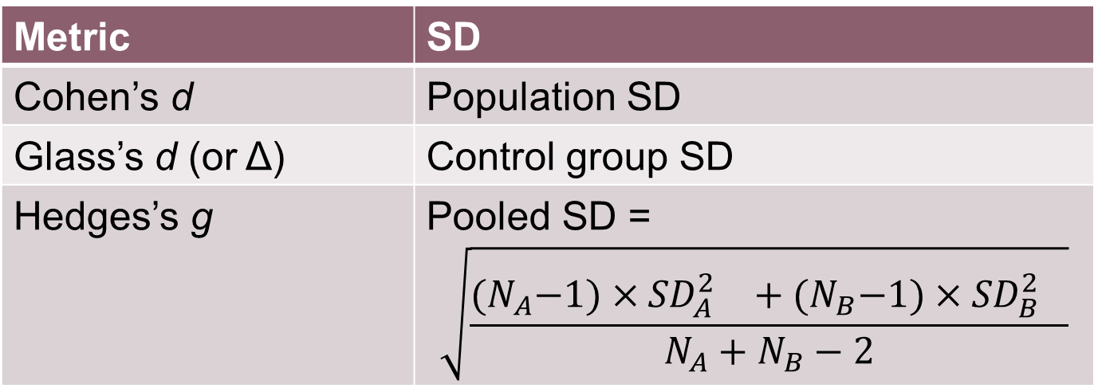
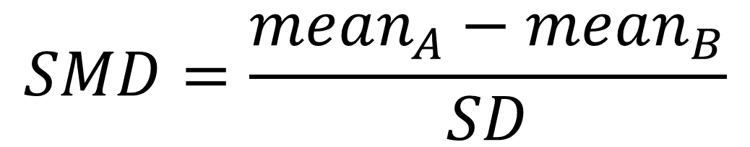
Revision from last time: stand. mean diff. between two normally distributed groups
$$SMD=\frac{mean_{A}−mean_{B}}{SD}$$
Metric | SD
Cohen’s d | Population SD
Glass’s d (or Δ) | Control group SD
Hedges’s g | Pooled SD = $$\sqrt{\frac{{(N}_{A}−1)×{{SD}_{A}^{2}}^{}+{(N}_{B}−1)×{{SD}_{B}^{2}}^{}}{N_{A}+N_{B}−2}}$$

Slide 19
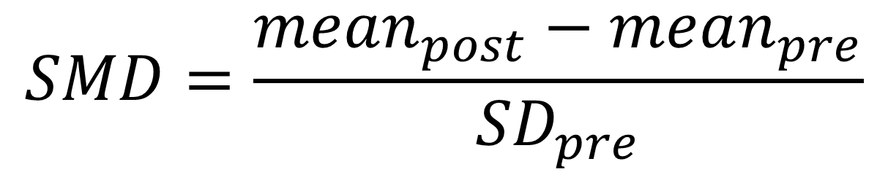
Within-person change (Becker, 1988)
$$SMD=\frac{mean_{post}−mean_{pre}}{{SD}_{pre}}$$
There are plenty of alternatives but this is the most straightforward

Slide 20
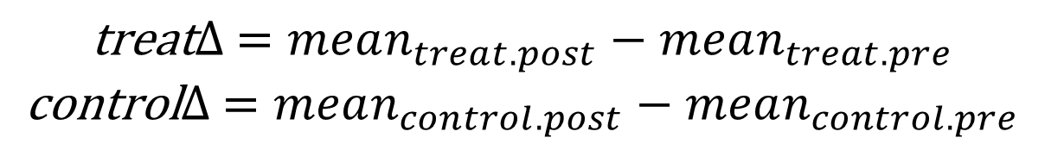
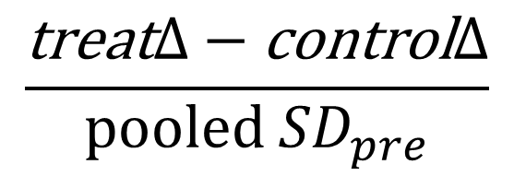
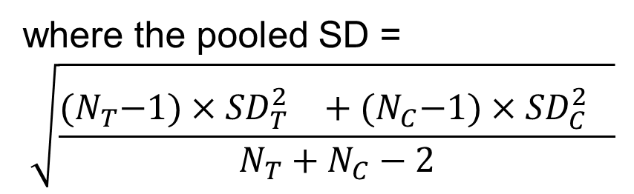
Pretest-Posttest-Control Group (Morris 2007)
First work out mean pre-post difference in treatment and control groups…
$$\text{treat}∆ =mean_{treat.post}−mean_{treat.pre}$$
$$\text{control}∆ =mean_{control.post}−mean_{control.pre}$$
Then take the standardised difference between these
$$\frac{\text{treat}∆−\text{control}∆}{\text{pooled} {SD}_{pre}}$$
where the pooled SD =
$$\sqrt{\frac{{(N}_{T}−1)×{{SD}_{T}^{2}}^{}+{(N}_{C}−1)×{{SD}_{C}^{2}}^{}}{N_{T}+N_{C}−2}}$$

Slide 21
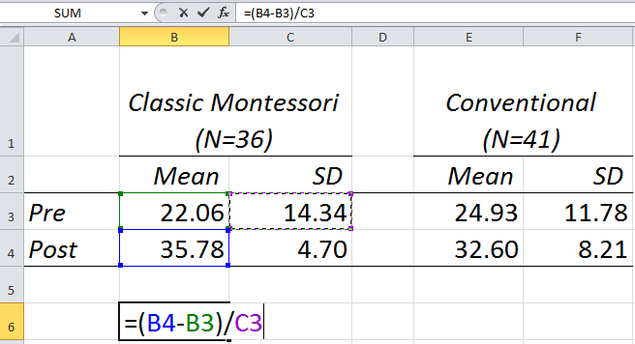
Tip: use Excel formulae (type “=” to start)

Slide 22
Activity: compute PPC effect size for this data (Head-Toes-Knees-Shoulders)
 | Classic Montessori (N=36) |  |  | Conventional (N=41)
 | Mean | SD |  | Mean | SD
Pre | 22.06 | 14.34 |  | 24.93 | 11.78
Post | 35.78 | 4.70 |  | 32.60 | 8.21
From Table 2 of Lillard, A. S. (2012). Preschool children’s development in classic Montessori, supplemented Montessori, and conventional programs. Journal of School Psychology, 50(3), 379–401.

Slide 23
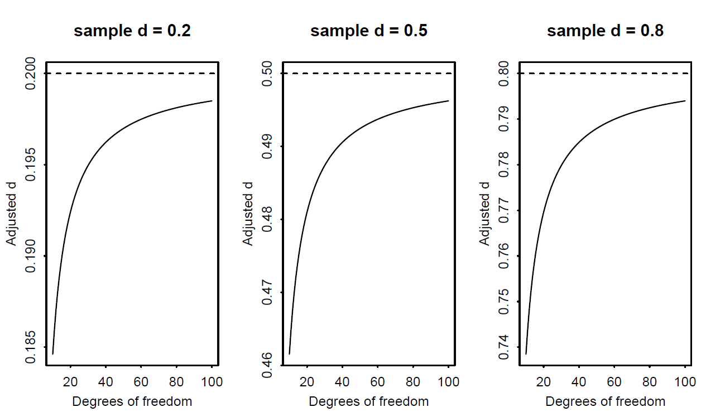
Minor complication: the standardised mean difference is a little biased for small samples

Slide 24

Adjusting for bias (Hedges 1981, p.114)
Multiply d by
… where m is the degrees of freedom (for two-group comparisons: total sample size – 2)
Or use software which does this for you

Slide 25
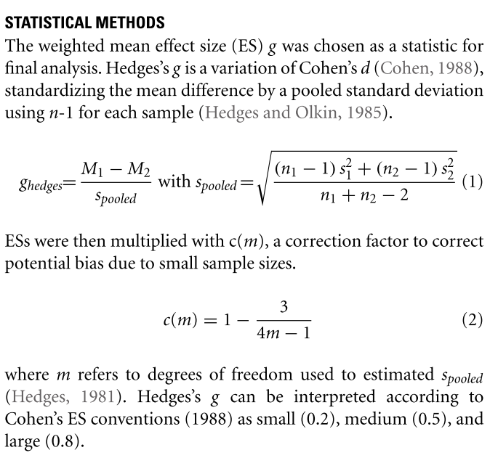
Zenner, C., Herrnleben-Kurz, S., & Walach, H. (2014). Mindfulness-based interventions in schools—A systematic review and meta-analysis. Frontiers in Psychology, 5, 603. doi:10.3389/fpsyg.2014.00603

Slide 26
Detecting publication bias using a funnel plot

Slide 27
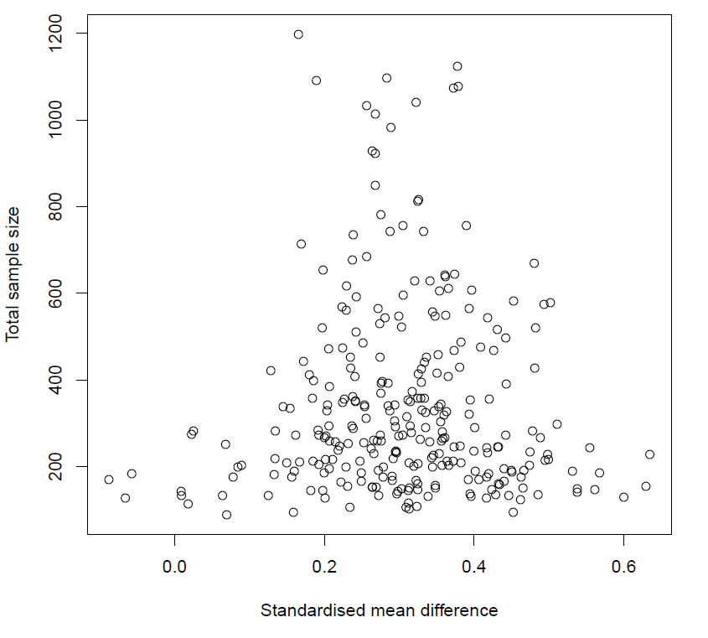
Expected between-study variation in effects

Slide 28
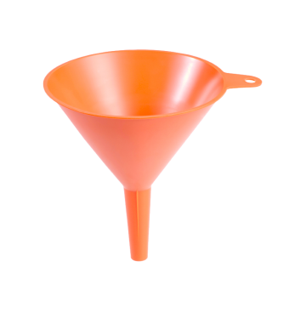
Expected between-study variation in effects

Slide 29
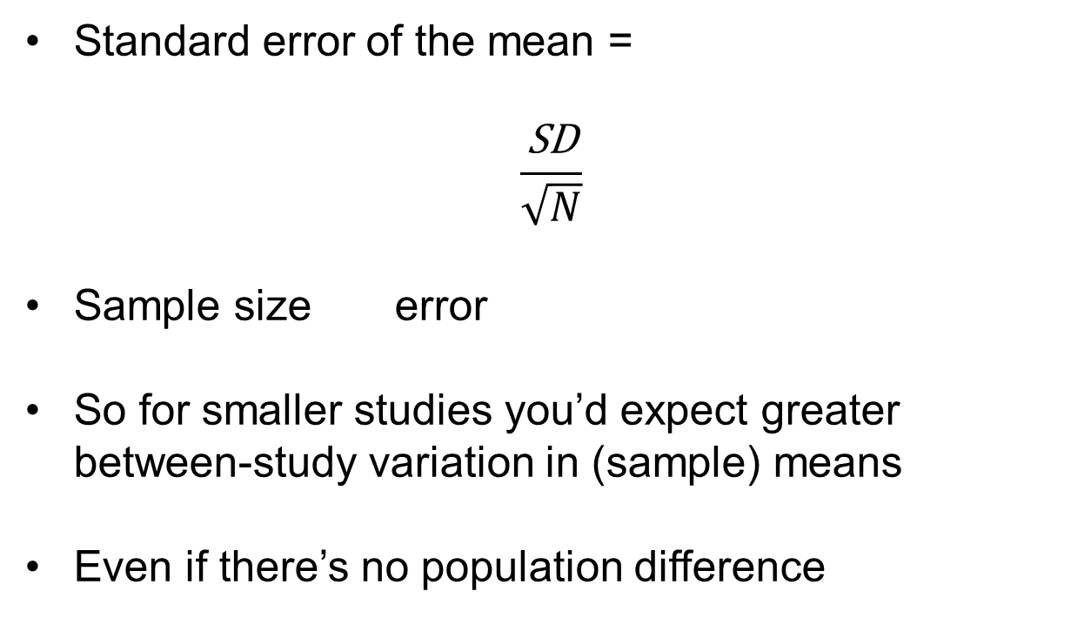
Why this funnel shape?
Standard error of the mean =
$$\frac{\text{SD}}{\sqrt{N}}$$
Sample size error
So for smaller studies you’d expect greater between-study variation in (sample) means
Even if there’s no population difference

Slide 30
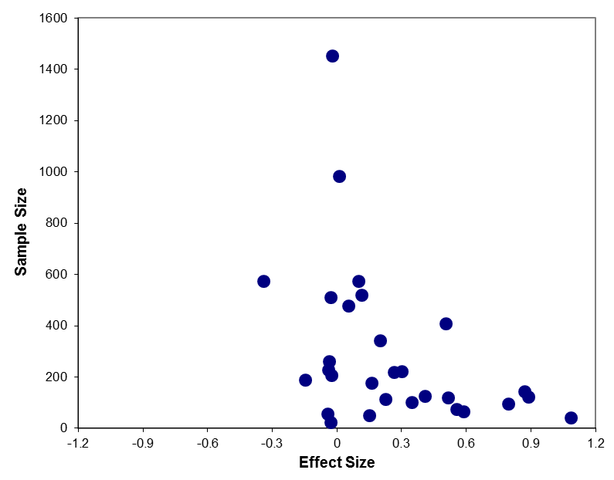
An unpublished (but oft-cited) meta-analysis
Something missing?
overall effect d = 0.21
Sapyta, J. J. (2004). The effect of the provision of information on client status toward clinician behavior and outcome: a meta-analysis. Major Area Paper, Submitted to the Faculty of Peabody College of Vanderbilt University.

Slide 31
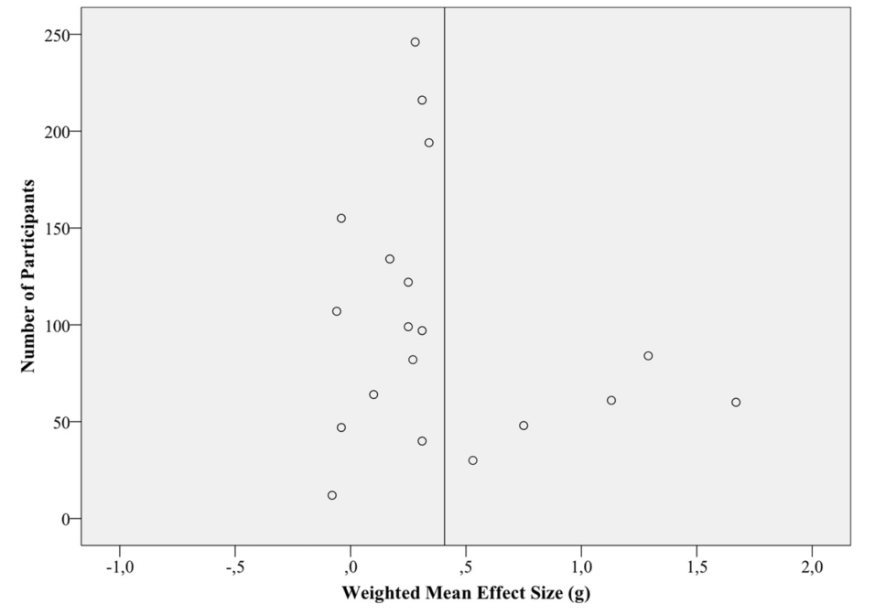
Zenner, C., Herrnleben-Kurz, S., & Walach, H. (2014). Mindfulness-based interventions in schools—A systematic review and meta-analysis. Frontiers in Psychology, 5, 603. doi:10.3389/fpsyg.2014.00603

Slide 32
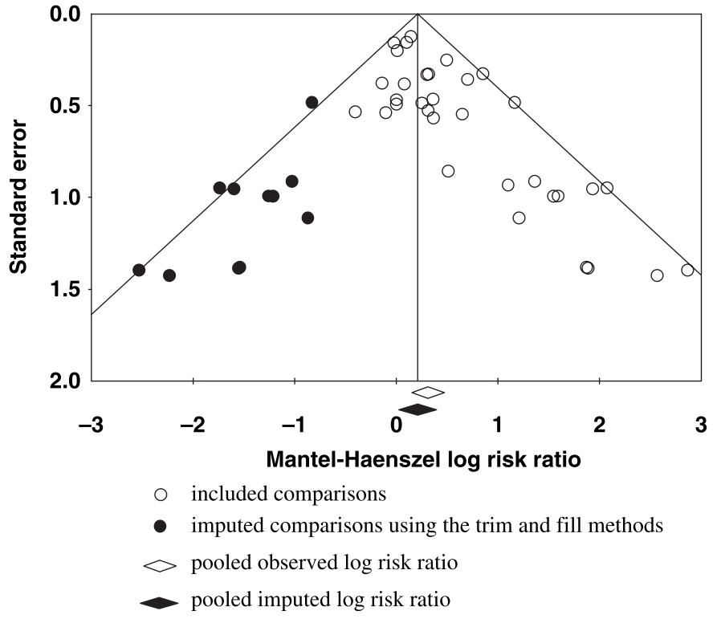
Watanabe, N., Hunot, V., Omori, I. M., Churchill, R., & Furukawa, T. A. (2007). Psychotherapy for depression among children and adolescents: a systematic review. Acta Psychiatrica Scandinavica, 116(2), 84–95.

Slide 33
Testing for effect consistency

Slide 34
Why test?
Often you want to decide whether to implement an expensive (people’s time and energy – you, teachers, families!) intervention
On average an intervention might work well…
… but what if there’s a lot of variation between effects depending on who ran the study and in what context
Problem: effects can also vary because of randomness…

Slide 35
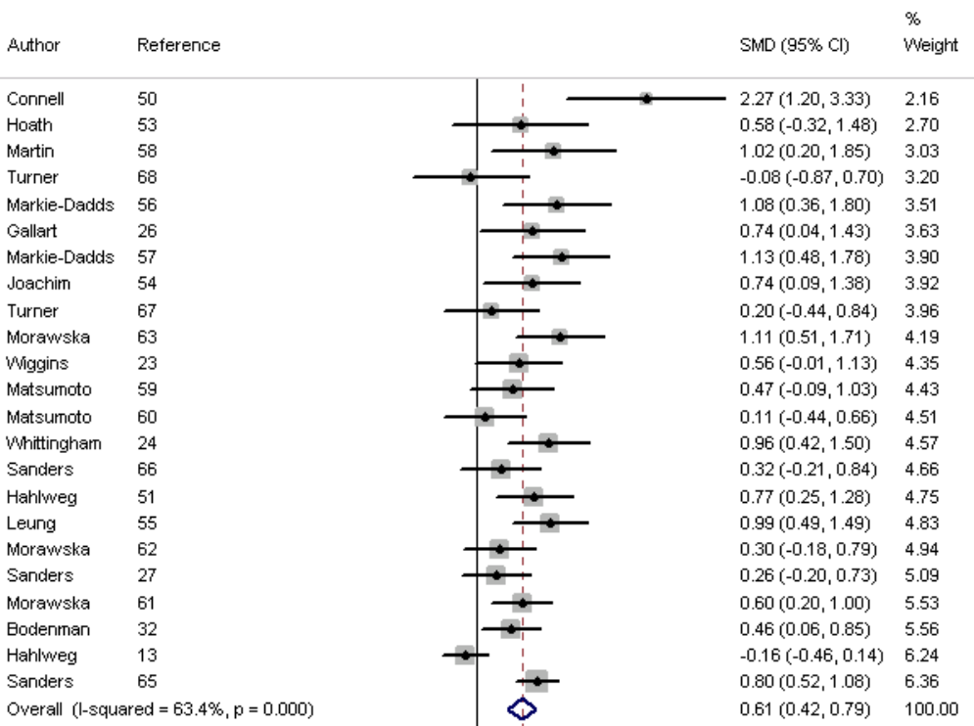
Wilson, P., Rush, R., Hussey, S., Puckering, C., Sim, F., Allely, C. S., … Gillberg, C. (2012). How evidence-based is an “evidence-based parenting program”? A PRISMA systematic review and meta-analysis of Triple P. BMC Medicine, 10, 130. doi:10.1186/1741-7015-10-130

Slide 36
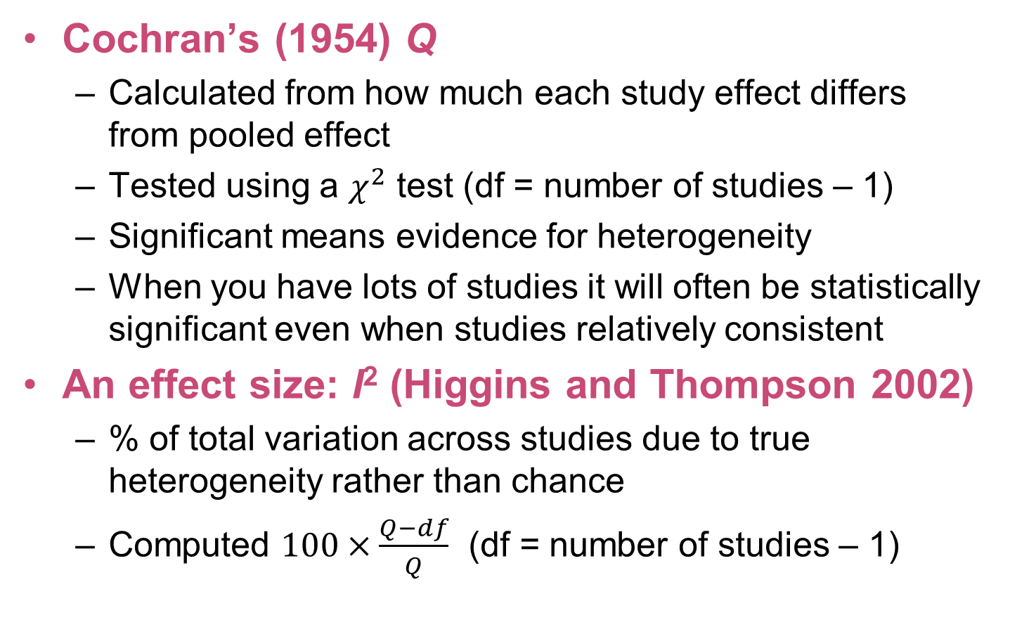
Tests for heterogeneity
Cochran’s (1954) Q
Calculated from how much each study effect differs from pooled effect
Tested using a $χ^{2}$ test (df = number of studies – 1)
Significant means evidence for heterogeneity
When you have lots of studies it will often be statistically significant even when studies relatively consistent
An effect size: I² (Higgins and Thompson 2002)
% of total variation across studies due to true heterogeneity rather than chance
Computed $100×\frac{Q−df}{Q}$ (df = number of studies – 1)

Slide 37
Thresholds for interpreting I² from Cochrane Handbook for Systematic Reviews of Interventions
A rough guide to interpretation is as follows:
0% to 40%: might not be important
30% to 60%: may represent moderate heterogeneity
50% to 90%: may represent substantial heterogeneity
75% to 100%: considerable heterogeneity
Depends on direction and magnitude of individual effects and whether statistically significant

Slide 38
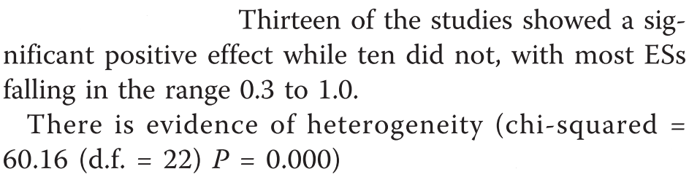
Exercise
Warmup: how many studies were there?
Calculate I²
What does it mean?

Slide 40
Moderators

Slide 41
Moderators
Analogous to interaction effect in primary analyses
Asks what factors might vary the outcome
Can be methodological, e.g.,
what measure was used
the quality of the study
Substantive, e.g.,
related to underlying mechanisms
variant of an intervention used
contextual factors such as gender, ethnicity, social class

Slide 42
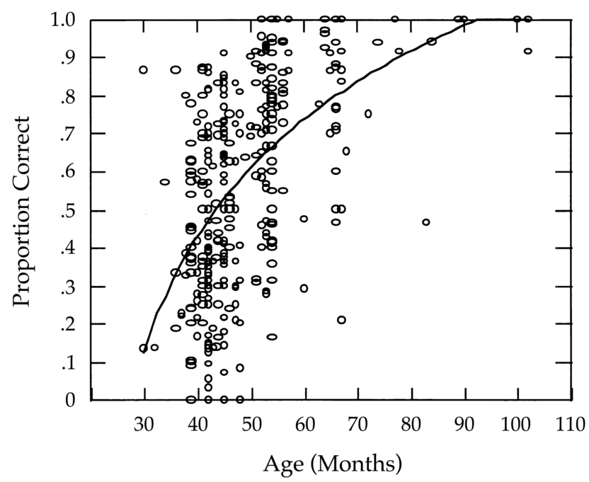
Wellman, H. M., Cross, D., & Watson, J. (2001). Meta-analysis of theory-of-mind development: the truth about false belief. Child Development, 72(3), 655–84.

Slide 43
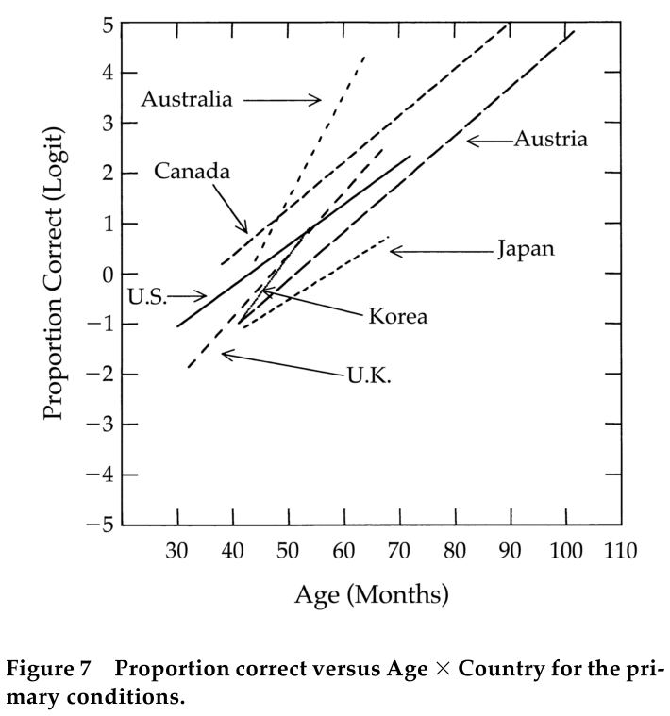
Wellman, H. M., Cross, D., & Watson, J. (2001). Meta-analysis of theory-of-mind development: the truth about false belief. Child Development, 72(3), 655–84.

Slide 44
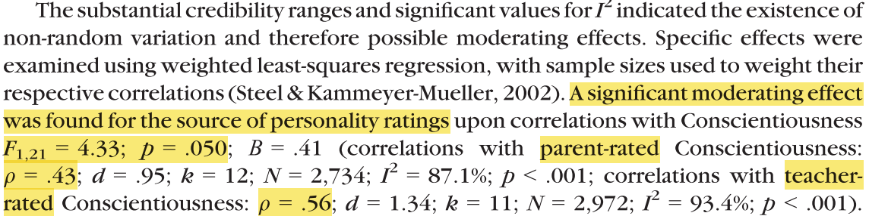
Big 5 conscientiousness vs. academic performance
Poropat, A. E. (2013). A meta-analysis of adult-rated child personality and academic performance in primary education. British Journal of Educational Psychology. doi:10.1111/bjep.12019

Slide 45
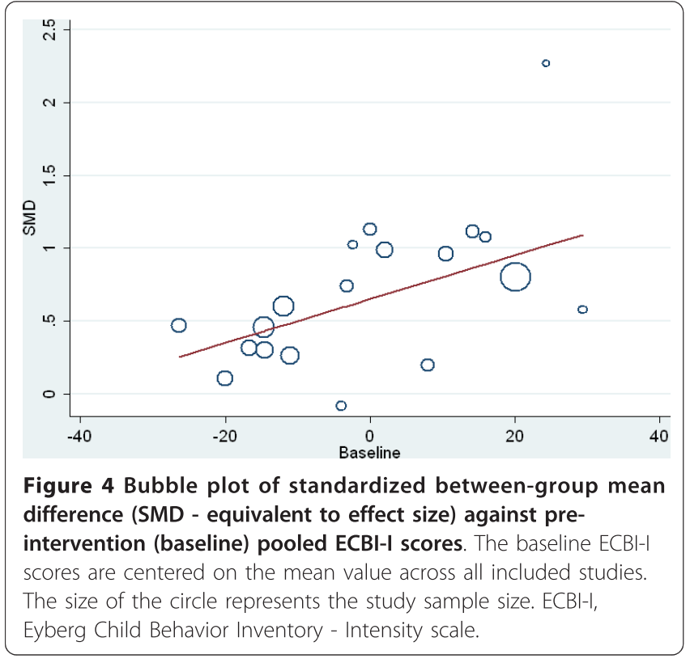
Wilson, P., Rush, R., Hussey, S., Puckering, C., Sim, F., Allely, C. S., … Gillberg, C. (2012). How evidence-based is an “evidence-based parenting program”? A PRISMA systematic review and meta-analysis of Triple P. BMC Medicine, 10:130.

Slide 46
Fitting the actual meta-analysis

Slide 47
For the DECPsy…
You’re “only” expected to collect effect size metrics and interpretations (hard work!)
Also include N
Where possible, include a 95% CI of the effects
But you may (now or in future) also want to fit the full model…

Slide 48
Software
One possibility: the metafor package in R
http://www.metafor-project.org
http://www.r-project.org
Free
Implements a range of techniques

Slide 49
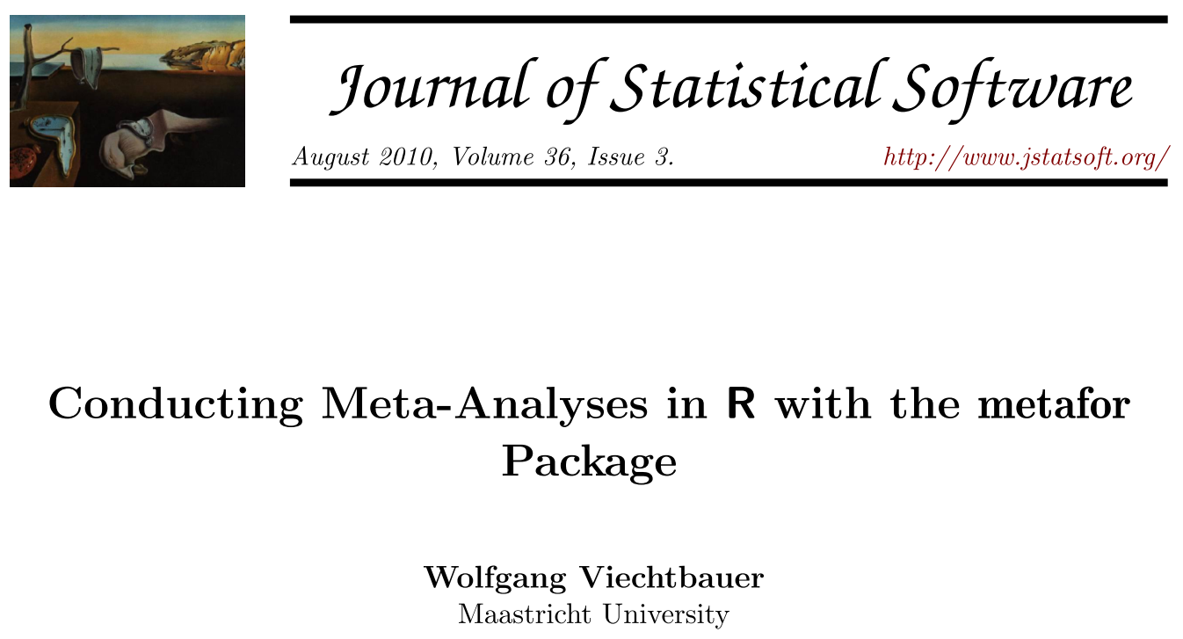

Slide 50
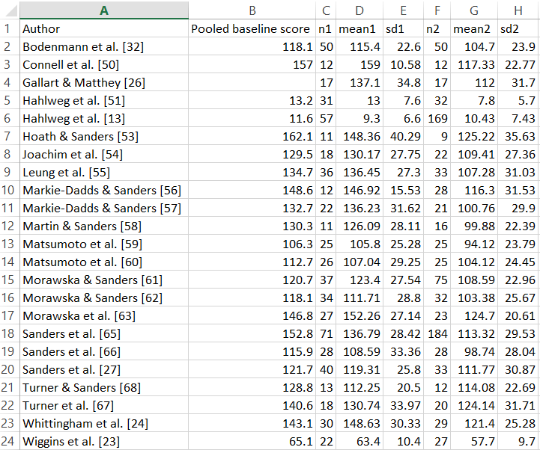
Enter the data in Excel and save as a “txt” file.

Slide 51
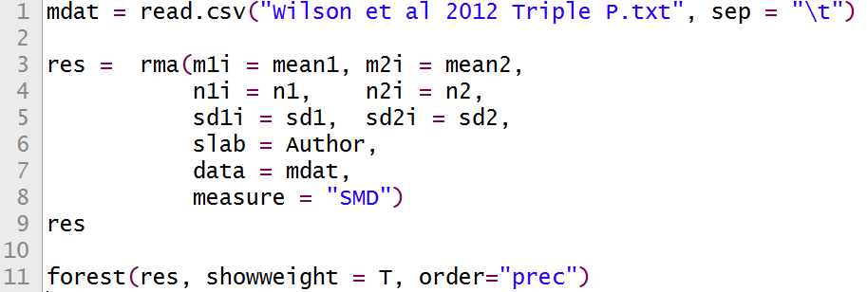
Read the file and run the analysis
(this is all the code required!)

Slide 52
Forest plot

Slide 53
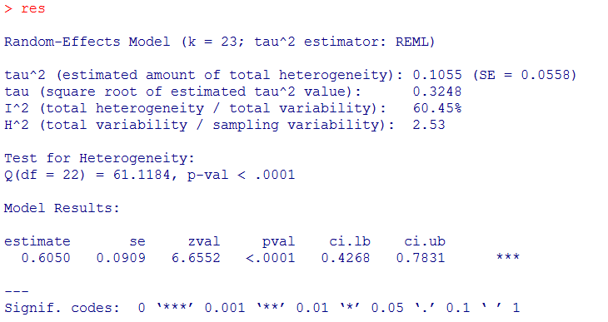
Tests for heterogeneity and other goodies

Slide 54
Key points
Meta-analyses are useful so everywhere now!
Hardest part is the systematic reviewing and calculating effect sizes
The final analysis can be run using free software

Slide 55

Postscript on “meta”: why you can’t ask a genie for more wishes (see Hofstadter 1979)
A wish about wishes is a meta-wish
If you could ask a genie for a meta-wish then you could wish that your wish not be granted
If it were granted then it wouldn’t be
If it weren’t granted then it… still wouldn’t be
So meta-wishes aren’t allowed
(Top tip for avoiding the 3-wish limit: You can ask a meta-genie)

Slide 56
The end!

